Slide 1
ENGLISH
HINDI
MENU
SETTINGS

Slide 2
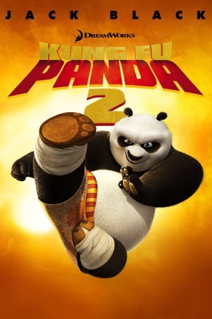
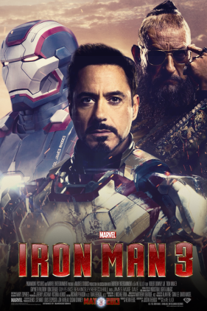
KUNG FU PANDA 2
IRON MAN 3
BACK
EXIT

Slide 3

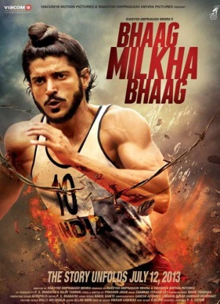
3 IDIOTS
BHAAG MILKHA
BHAAG
BACK
EXIT

Slide 4
SCREEN
S4
S5
S6
S1
S2
S3
G4
G5
G6
G1
G2
G3
BACK
PAY

Slide 5



Slide 6
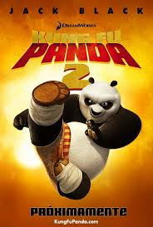
KUNG FU PANDA 2
In the film, Po and his friends battle to stop a would-be conqueror Lord Shen with his powerful new weapon, with the giant panda discovering a disquieting link to his past in the process.
Rating : 7.2/10
U
NEXT
BACK

Slide 7
IRON MAN 3
In Iron Man 3, Tony Stark tries to recover from posttraumatic stress disorder caused by the events of The Avengers, while investigating a terrorist organization led by the mysterious Mandarin.
Rating : 7.4/10
U/A
NEXT
BACK

Slide 8
3 IDIOTS
Two friends are searching for their long lost companion. They revisit their college days and recall the memories of their friend who inspired them to think differently, even as the rest of the world called them "idiots".
Rating : 8.5/10
U/A
NEXT
BACK

Slide 9

BHAAG MILKHA BHAAG
The truth behind the ascension of Milkha "The Flying Sikh" Singh who was scarred because of the
India-Pakistan partition.
Rating : 8.5/10
U
NEXT
BACK

Slide 10
ENTER PASSWORD
TO RESET ALL SEATS
MAKE SURE
CAPS LOCK IS
TURNED OFF
PRESS
ENTER TO
PROCEED
TO GO
BACK PRESS
ENTER

